Slide 1

Unemployment and cause-specific mortality in the Belgian working-age population
Vanthomme K, Gadeyne S (2019). Unemployment and cause-specific mortality among the Belgian working-age population: The role of social context and gender. PLoS ONE 14(5): e0216145.
Symposium CausIneq
21-10-2019 | 1

Slide 2
RATIONALE of this study
  Increase in life expectancy but not equally among socioeconomic groups, e.g. educational differences
  Shifts in employment patterns
    Stable and predictable --> more flexible and uncertain
    Increase in probability of getting unemployed
    Other groups than traditional ones: women, young, high-educated
Symposium CausIneq
21-10-2019 | 2
Notes:
- Life expectancy has increased substantially in industrialized countries in the last decades [1]. However, important differences in life expectancy, morbidity and mortality are observed between socioeconomic (SE) groups. Reducing SE inequalities in health and mortality are one of the major challenges of public health policies nowadays, even in western countries with high-quality and accessible health care systems.
- The probability of getting unemployed has increased in recent decades, which could possibly have a rather large public health impact.
- As mentioned earlier, unemployment is now also increasingly affecting other groups than the ‘traditional ones’ [9], e.g. the young, the high-educated, or women.

Slide 3
Study aims
  Unemployment ~ mortality?
    → for which causes of death (COD)?
  Variation in this association by other indicators of social disadvantage?
    E.g. being single, low-educated,…
  Variation by gender?
Symposium CausIneq
21-10-2019 | 3
Notes:
While many studies have documented educational inequalities in morbidity and mortality, employment status has less often been used as indicator of socioeconomic position (SEP) in relation to health.
→ RQ1: to assess whether unemployment is associated with higher mortality risks and if so for which specific causes of death (COD)
Yet, few studies have paid attention as to whether the association between unemployment and health varies by other indicators of social disadvantage. Such studies could however gain information on the pathways linking unemployment and health single indicators of SEP do not maximally discriminate between social groups, we will add other socioeconomic (i.e. educational attainment and home ownership) and sociodemographic indicators (i.e. the presence of a partner and migrant background) into the models to see whether these may protect against the detrimental health effects of being unemployed.
→ RG2: do SD and SE factors protect against the detrimental health effects of being unemployed?
RQ3: Assess whether the association between unemployment, SEP and cause-specific mortality varies by gender?

Slide 4
Dataset
  Individually-linked population-wide dataset
  Sociodemographic and socioeconomic information
  Cause-specific mortality
Census
01/10/2001
Register data
2001-2011
Death certificates
2001-2011
Symposium CausIneq
21-10-2019 | 4
Notes:
Analyses were based on a population-wide dataset, consisting of a record linkage between the 2001 Belgian census and Register data on emigration and cause-specific mortality for the period 1st October 2001-31st December 2011. The dataset contained census-based information on socio-demographic and SE characteristics as well as cause-specific mortality figures for the total de jure Belgian population.
Census data
Sociodemographic data (gender, age, household composition, ethnicity, place of residence,…)
Socioeconomic data (educational attainment, housing conditions, occupation,...)
Register data
Mortality
Emigration
Death certificates
Underlying cause of death (ICD-10 classification)

Slide 5
Study population
  Belgian population aged 25-59 years
  Eligible for employment at census 2001
  In good or very good self-rated health at census 2001
  N: 1,693,799 men and 1,390,338 women
Symposium CausIneq
21-10-2019 | 5
Notes:
The study population comprised the Belgian population aged 25 to 59 years at census 2001,
eligible for employment and in good health (N = 3,084,137).
- Limiting the analyses to the 25 to 59-year olds excludes those who may be still studying (<25 years) and those who are at the
end-of-career periods (60 and older), which leads to a more homogenous study population.
Moreover, to capture the population eligible for employment, students, retirees and people not working because of personal, social or health reasons as well as unemployed people not actively looking for a job were excluded from the study population.
To exclude a health selection effect, people that claimed to be in ‘fair’, ‘poor’ or ‘very poor’ health at the moment of the 2001 census
were also excluded from the analyses.

Slide 6
Variables of interest
  Outcome: cause-specific mortality
    ICD-10 chapters and major single COD (e.g. diabetes, ischaemic heart diseases and transport accidents)
  Unemployed but actively looking for a job versus employed (<census 2001)
  Sociodemographic/socioeconomic variables (<census 2001)
    Educational attainment ~ ISCED
    Home ownership
    Partnership
    Migration background
Symposium CausIneq
21-10-2019 | 6
Notes:
COD were classified according to the ICD-10. The COD were grouped according to the chapters of ICD-10 (highlighted in grey in the cause-specific tables and called ‘major groups of COD’)). In addition, major single COD such as diabetes, ischaemic heart disease and transport accidents were examined separately.
Employment status at the time of the census 2001, contrasting employed and unemployed people who were actively looking for a job.
Educational attainment: lower secondary education or less (ISCED 0–2, “low”), upper secondary education (ISCED 3–4, “mid”), and tertiary education (ISCED 5–6, “high”).
Home ownership differentiates between tenants and owners of a dwelling.
Living situation discriminates people living without partner from people living with partner.
Migration background separates native Belgians from non-native Belgians.

Slide 7
Statistical analyses
  Absolute inequalities
    Age-standardized mortality rates (ASMR) by employment status and gender for all-cause and cause-specific mortality
    Mortality rate difference (MRD): ASMR_{unemployed} - ASMR_{employed}
  Relative inequalities
    Age-adjusted mortality rate ratios (MRR) by means of Poisson regression by employment status as well as for the other indicators of social disadvantage
  Cross-classification of employment status and other measures of social disadvantage
Symposium CausIneq
21-10-2019 | 7
Notes:
- First, for all-cause and cause-specific mortality, directly age-standardized mortality rates (ASMR) were calculated by employment status and gender, using the total Belgian population at the 2001 census as standard population. + Mortality rate difference (MRD) = ASMR of the unemployed - ASMR of the employed group.
all-cause and cause-specific mortality rate ratios (MRR) were calculated using Poisson regression models.
In a first step, these models were only adjusted for attained age
in a second step, the other indicators of social disadvantage were added to the model.
Furthermore, for all-cause mortality the association between the cross-classifications of employment status and the other measures of social disadvantage was assessed using both ASMR and MRR.
Additionally, we performed some sensitivity analysis among the ‘unhealthy group’. We assessed whether the association between employment status and all-cause and cause-specific mortality holds true among the unhealthy group as well. To study this, both ASMR and MRR were calculated for all-cause and cause-specific mortality.

Slide 8
Main findings
  4.5% of men and 9.4% of women was unemployed and looking for a job
  Unemployed men and women were more often in other disadvantaged positions
    for all other indicators and both genders
    E.g.: home ownership: 77.9% of the employed versus 49.6% of the unemployed men
Symposium CausIneq
21-10-2019 | 8
Notes:
Compared with employed men and women, the unemployed were more likely to be in a socially disadvantaged position. While women were more often higher educated than men, both unemployed men and women were more often lower educated compared with their employed counterparts. Almost three out of four employed men and women were owner of a dwelling, but this percentage decreased among the unemployed to about 50% of the unemployed men and 60% of the unemployed women. Among men, the unemployed were more likely to be living without partner, whereas the majority of the women was living with a partner even if the proportion of women living without partner was higher among the unemployed. Finally, the percentage of men and women with a migrant background was higher among the unemployed than among the employed.

Slide 9
Main findings
  Unemployment ~ all-cause and cause-specific mortality
  Association was stronger among men than among women
Symposium CausIneq
21-10-2019 | 9

Slide 10
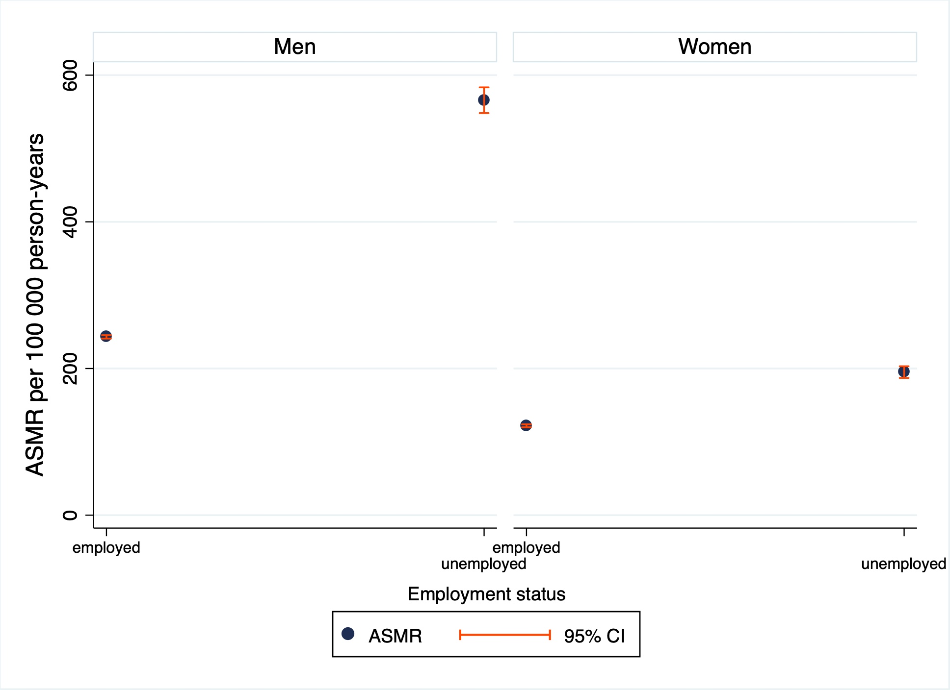
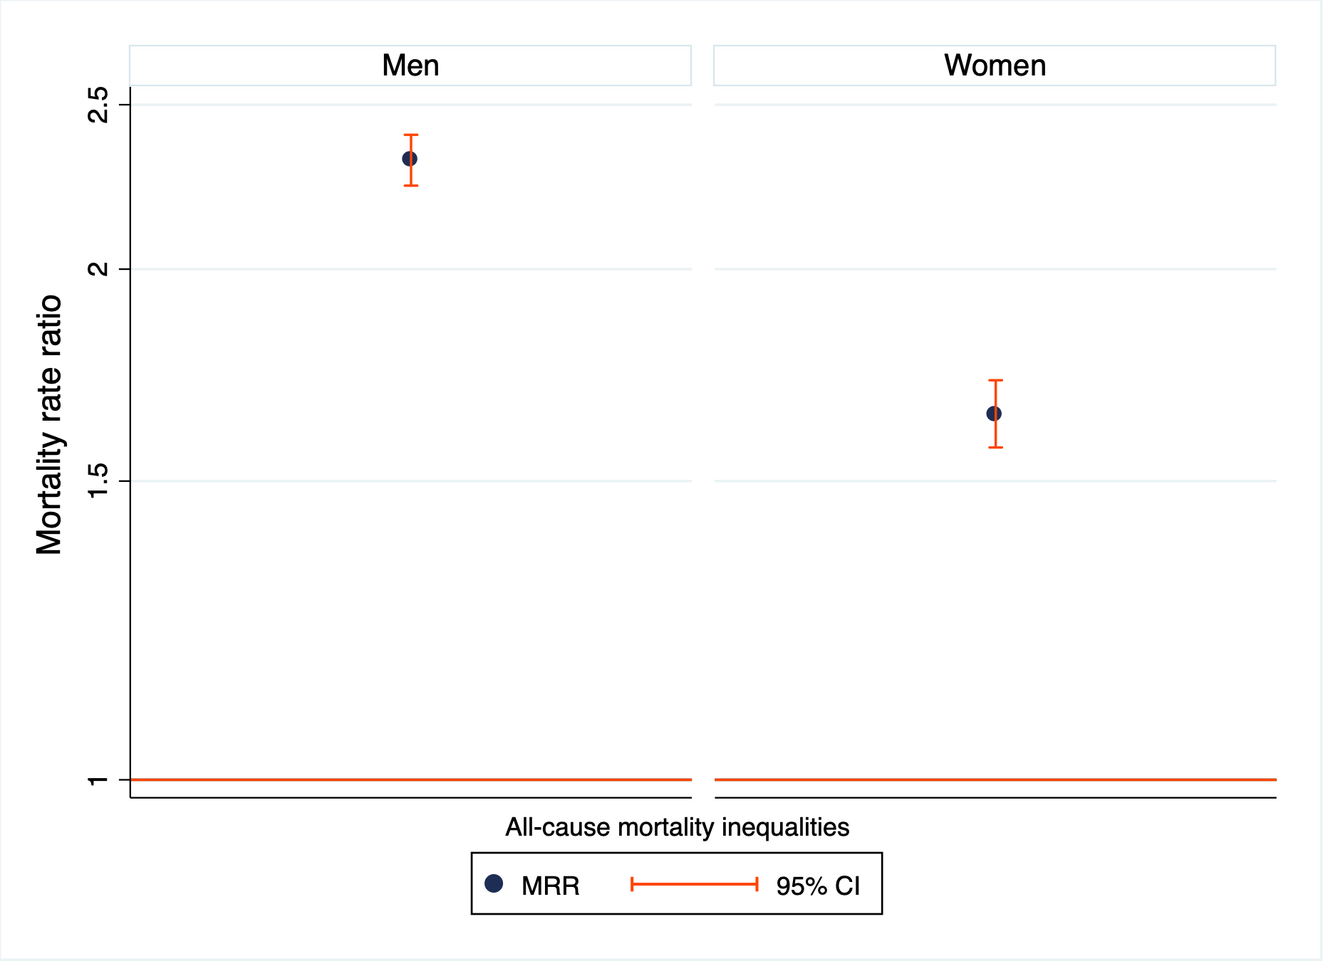
All-cause mortality by employment status, by gender
Absolute inequalities
Relative inequalities
565.8
2.32
MRD = 322.7/100,000
MRD = 73.2/100,000
243.1
1.64
195.1
121.9
MRR of unemployed but looking for a job versus employed
Symposium CausIneq
21-10-2019 | 10
Notes:
This association was stronger among men than among women: in absolute terms employed men had an all-cause ASMR of 243.1/100,000 person-years (95% CI: 240.8–245.5) whereas unemployed men had an all-cause ASMR of 565.8/100,000 person-years (95% CI: 548.3–583.4) resulting in a mortality rate difference of 322.7/100,000 (Table 3). Among women, the absolute difference in all-cause mortality between unemployed and employed women was much smaller: 73.2/100,000 (ASMR_{unemployed} = 195.1/100,000 –ASMR_{employed} = 121.9/100,000). In relative terms, male all-cause mortality was twice as high among the unemployed compared with the employed (MRR: 2.32; 2.24–2.40), while among unemployed women, all-cause mortality was 64% higher compared with employed women (MRR: 1.64; 1.57–1.72).

Slide 11
Main findings
  For almost all causes of death
  Strongest inequalities for:
    Absolute: cancers, circulatory diseases and external COD
    Relative: mental disorders, digestive, endocrine, infectious and respiratory diseases and external COD
Symposium CausIneq
21-10-2019 | 11
Notes:
This adverse association between unemployment and mortality (measured both absolute and relative) was persistent for all major groups of COD, as well as for all major single COD, both among men and women.
The largest relative mortality inequality between employed and unemployed men and women was noted for mortality due to mental disorders related to alcohol, resulting in MRRs of respectively 7.60 (95% CI: 6.17– 9.37) for men and 4.26 (95% CI: 2.84–6.38) for women (Table 4). The excess mortality due to falls was also very large among the unemployed with mortality rates that were almost five times as high among men (4.77; 95% CI: 3.50–6.49) and almost four times as high among women (3.68; 95% CI: 2.24–6.06). Large mortality inequalities were also observed for respiratory and digestive diseases: relative mortality inequalities for alcoholic liver disease, liver cirrhosis, pneumonia and chronic lower respiratory infections were among the largest for both men and women with MRRs above three. In addition, unemployed men and women had a three times higher chance of dying from diabetes (MRRmen: 3.12; 95% CI: 2.12–4.59 and MRRwomen: 3.56; 95% CI: 1.96–6.45) compared with employed men and women.

Slide 12
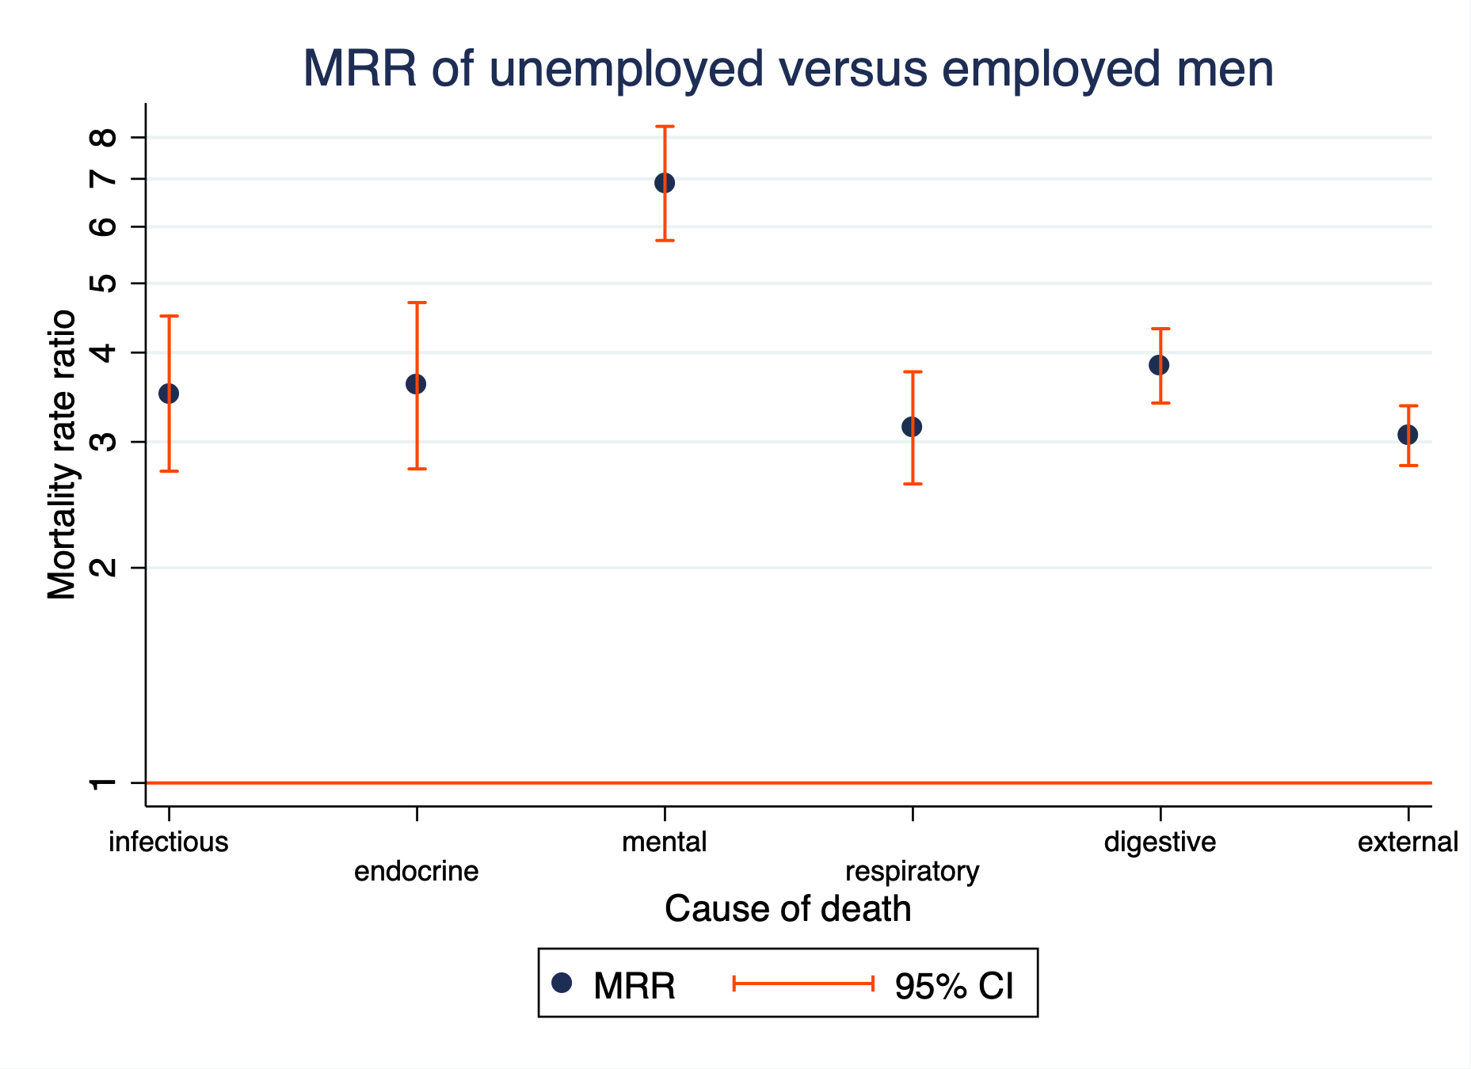
Relative mortality differences by employment status, Men
6.90
3.83
3.50
3.60
3.14
3.06
Symposium CausIneq
21-10-2019 | 12

Slide 13
Main findings
  The association between employment status and mortality persists after adjusting for other measures of social disadvantage
Symposium CausIneq
21-10-2019 | 13

Slide 14
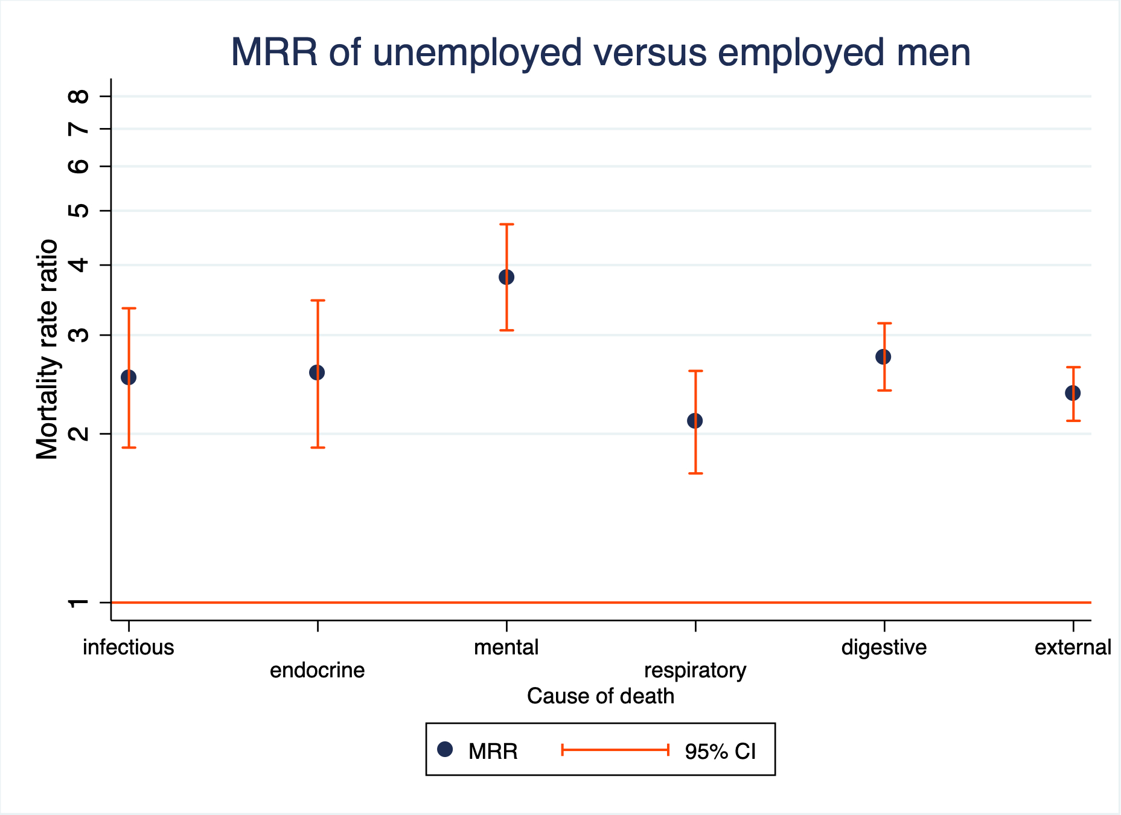
Unadjusted versus adjusted for other indicators of SEP
Age-adjusted model
Fully-adjusted model
6.90
3.83
3.80
3.50
3.60
3.14
3.06
2.74
2.36
2.52
2.56
2.10
Symposium CausIneq
21-10-2019 | 14
Notes:
Model 1: baseline model adjusted for attained age
Model 2: baseline model adjusted for attained age + educational attainment, home ownership, living situation and migrant background
Adding the other measures of social disadvantage to the model resulted in a significant decrease (the confidence intervals do not overlap) of the association between unemployment and all-cause mortality. This holds true for men and women, but the decrease was larger for men. Yet, a distinct mortality disadvantage for the unemployed people persisted for all COD, with dying from hypertensive diseases being the
only exception.

Slide 15
Main findings
  The association between employment status and mortality varies by other measures of social disadvantage
Symposium CausIneq
21-10-2019 | 15

Slide 16
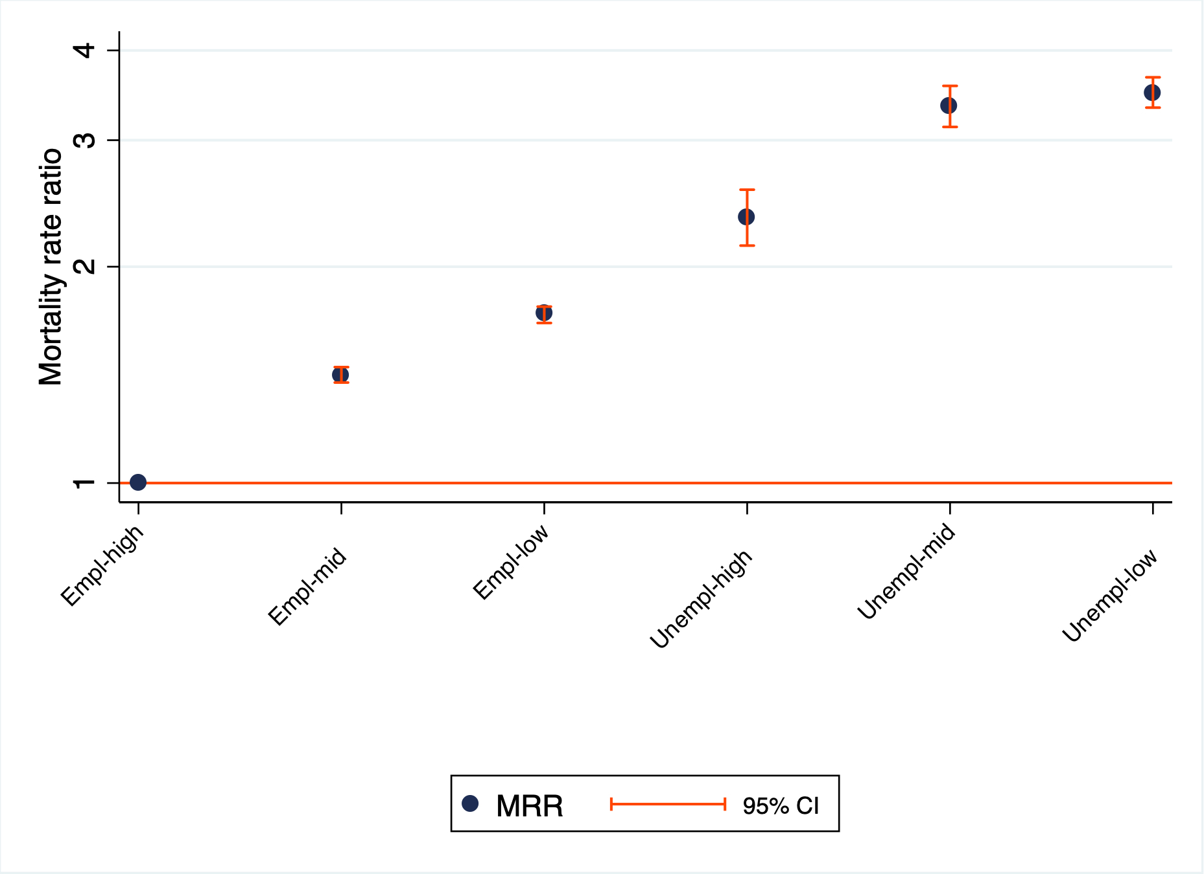
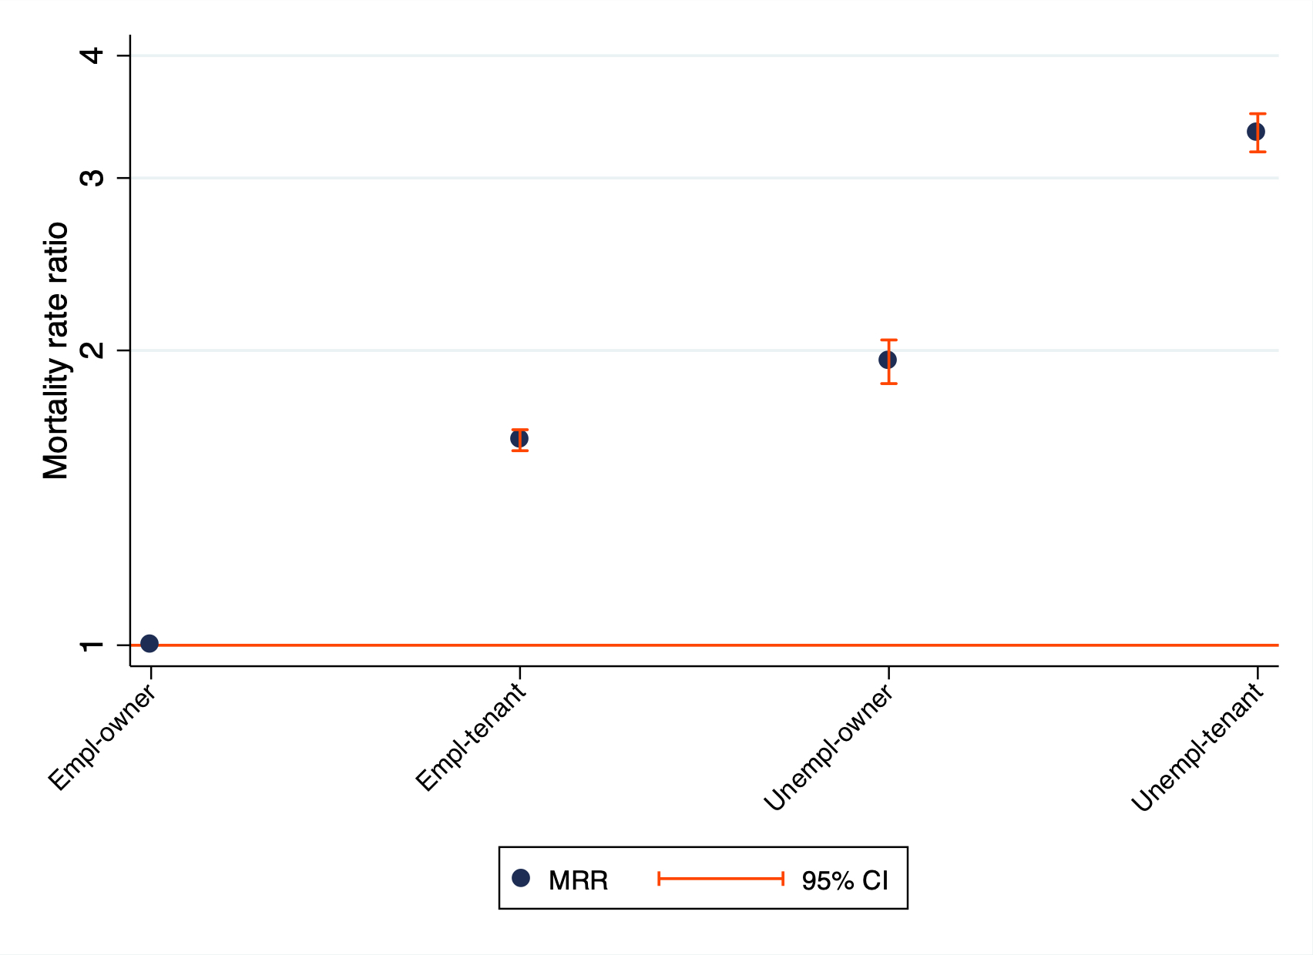
Cross-classification employment - measures of disadvantage
Employment - education, men
Employment - home ownership, men
Symposium CausIneq
21-10-2019 | 16
Notes:
unemployment discriminates more in terms of mortality than education, showing higher mortality among the unemployed, irrespective of their educational level, especially for men.
- when we look at the cross-classification between unemployment and ownership, we observed a cumulative disadvantage effect on mortality. Men and women who were both unemployed and tenants of the home they lived in had a highly disadvantageous mortality pattern compared with people who were exposed to only one of the indicators of social disadvantage.

Slide 17
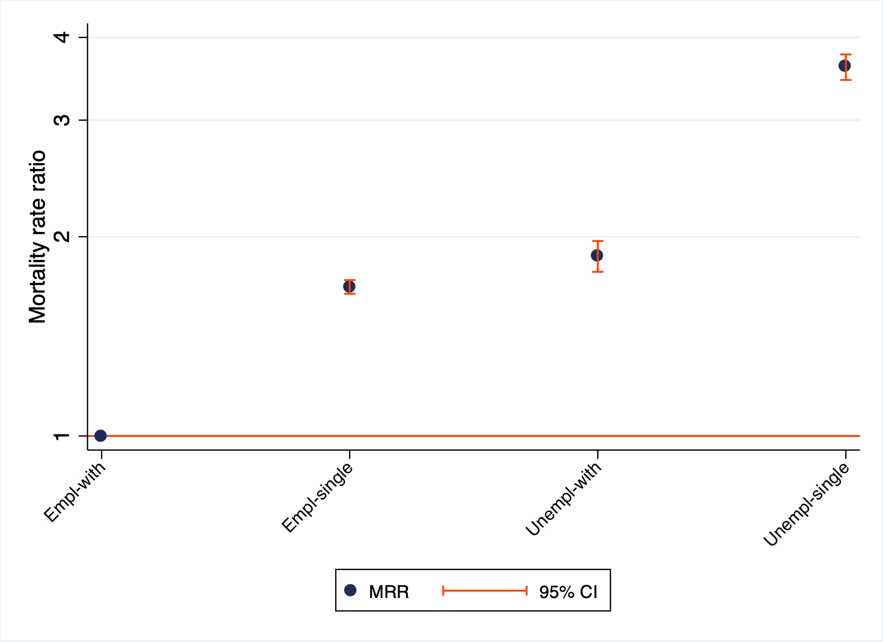
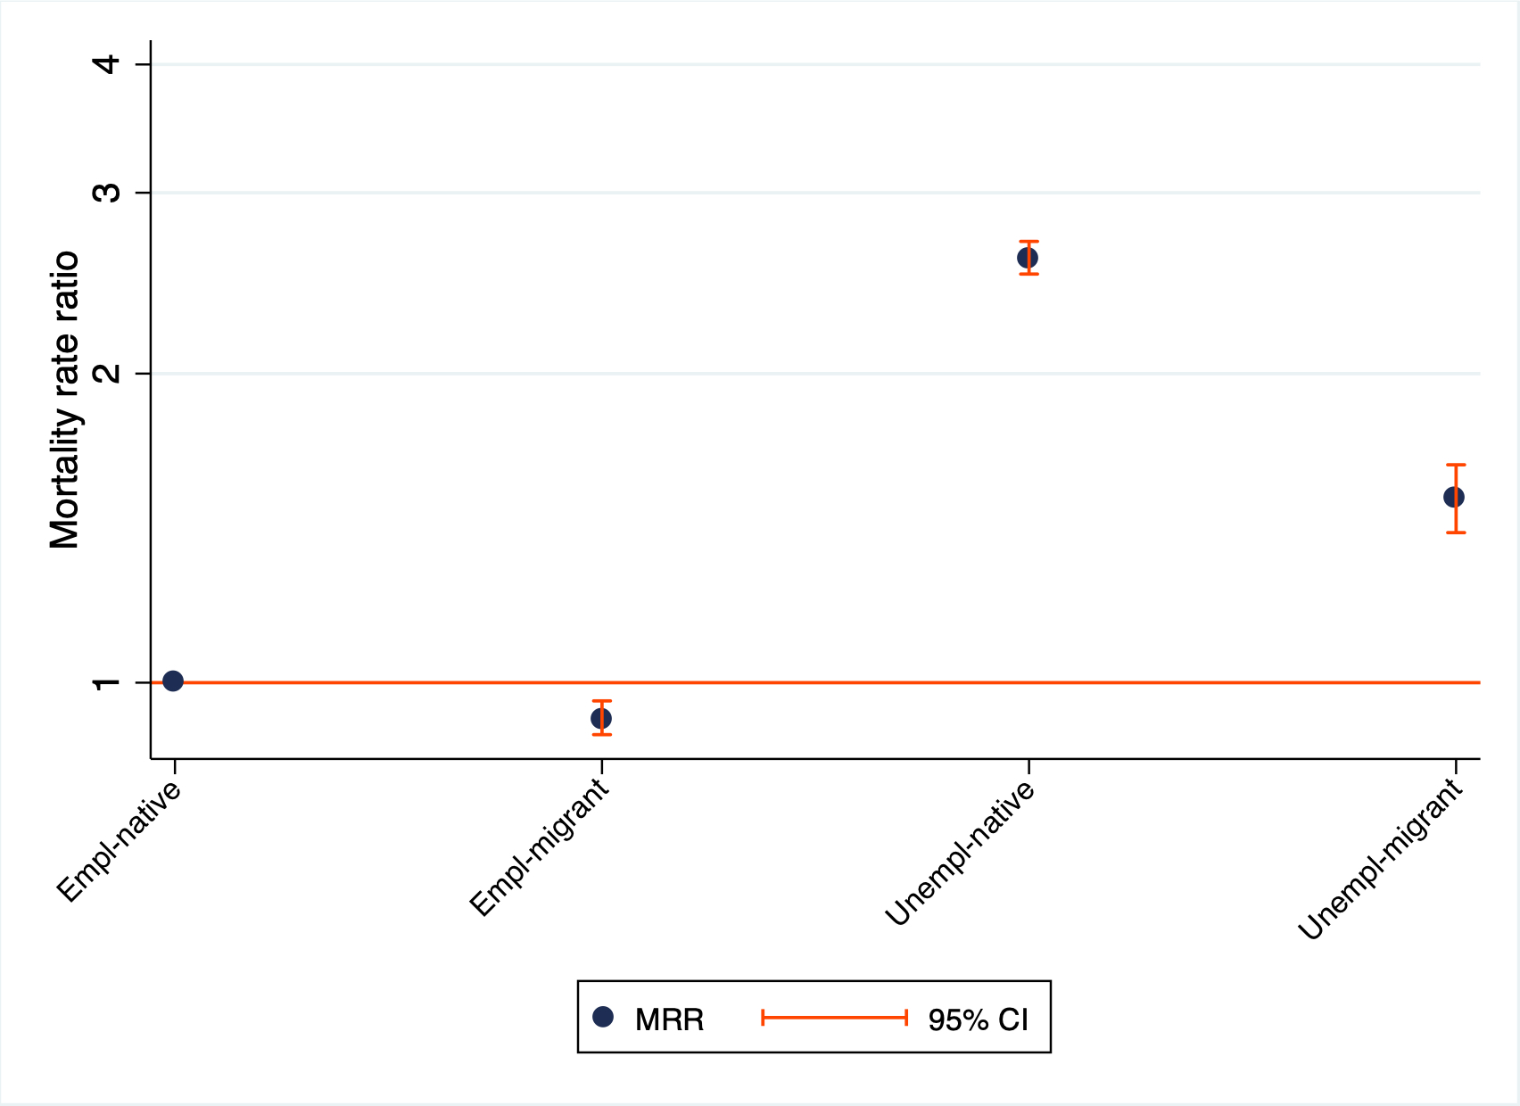
Cross-classification employment - measures of disadvantage
Employment - partnership, men
Employment - migrant background, men
Symposium CausIneq
21-10-2019 | 17
Notes:
Partnership: also cumulative disadvantage: Also, when it comes to the living situation, the results showed that unemployed men and women living without partner were more likely to die compared with employed men and women, as well as compared with unemployed men and women living with a partner.
Men and women with a migrant background had a mortality advantage compared with native Belgians, but the effect of being unemployed seemed to be stronger than migrant background.

Slide 18
Discussion
  Exhaustive, rich dataset
  Association between employment status and mortality + adjust for other measures of social disadvantage
  Unemployment measured at baseline → history of unemployment? Timing? Reasons? Regime?
  Health behaviour? Health care utilization?
  Health selection?
Symposium CausIneq
21-10-2019 | 18
Notes:
- Unemployment status was measured at baseline (census 2001), however we did not have information on the history of the employment trajectory, nor on the reasons for the job loss.
Timing! The association between joblessness and health might be stronger with longer durations of unemployment. Cumulative time spent in unemployment is associated with poor health, which is problematic as current employment trajectories are more and more fragmented and unstable. On the other hand, being unemployed as a result of an involuntary job loss or a mass lay-off may have a different association with health than being unemployed because of own resignation.
Additionally, we did not have information on health behaviours or health expenditure, which are thought to account (at least partly) for the higher mortality levels among the unemployed.
- The causal link between unemployment and poor health is likely to be bidirectional.
we reduced this probability by excluding individuals older than 59 years, Belgians who did not report good or very good self-rated health at baseline (census 2001), as well as individuals who were retired, who never had a job, who were unemployed but not actively looking for a job, and who were unemployed due to familial, social, personal, or health reasons
→ Sensitivity analyses showed that the mortality rates were indeed higher among the ‘unhealthy group’.
→ By excluding these unhealthy people at baseline, we assumed that among this subset of healthy individuals, unemployment was generally not caused by poor health, instead we assume that the elevated mortality rates
among the unemployed are related to the joblessness itself.
→ The sensitivity analyses showed that even in the ‘unhealthy group’, employment status remains associated with lower all-cause and cause-specific mortality (with only few COD as exceptions). This suggest that being at is associated with better health, even among this ‘unhealthy group’.

Slide 19
Wrap up
  Large mortality inequalities by employment status, even in the Belgian context
  Excess mortality particularly for COD related to adverse health behaviours
  Relation more pronounced among men
  Unemployment ~ other measures of social disadvantage
  Notwithstanding having a high position on other social scales, being unemployed remained associated with increased mortality
Symposium CausIneq
21-10-2019 | 19
Notes:
We would have expected that in a context of a welfare state with a generous social security system ensuring unemployment pays and people’s access to care (as is the case in Belgium), that there would have been smaller mortality differences by employment status
The observation that excess mortality was mainly observed for the behavioural COD and less for the COD associated with health care use, can be explained by the organization of care in Belgium, which is highly accessible through the system of social security. Moreover, for some COD (e.g. cancer), the observation period of eleven years might be too short to observe inequalities.
Largely, this difference can be attributed to the different traditional roles of men and women in society. Men remain most often the main economic provider within the household, while women are more often involved in the role of caregiver and housekeeper for the household. Therefore, having a good job and financial stability may have more effect on men’s health than on women’s health. Unemployed women with a family often have their basic income needs guaranteed by their partner’s income. Additionally, opposed to men, when women lose their job, they are more likely to replace the rewards they would gain from the job, by alternative rewards gained from their nursing role in the household
Moreover, the results showed that the other measures of social disadvantage did only slightly decrease the elevated cause-specific mortality risks among the unemployed. Yet, the results suggested that employment status seemed to be a more important marker for one’s health than the other indicators of social disadvantage

Slide 20
To do
  Special and tailored attention to tackle the adverse health status of vulnerable groups
  Add more detailed information on job history and employment characteristics
  Morbidity?
  Relatives of the unemployed?
Symposium CausIneq
21-10-2019 | 20
Notes:
- Following the higher unemployment levels among the lower social strata, especially in combination with simultaneously being in other lower social strata, implies for urgent matters. Special and tailored attention should be paid to tackle the adverse health status of these vulnerable groups such as people living without a partner or financially less secure groups. In this regard, ensuring financial security, good housing and accessible health care provision are key.
- information on the employment history, employment regimes such as part-time work, precarious work, temporal employment and job insecurity

Slide 21

Katrien.Vanthomme@vub.be
http://www.vub.ac.be/demography
Symposium CausIneq
21-10-2019 | 21

